Slide 1
COOPERATIVES:
A Biblical & Practical Response to Poverty in the Philippines
By Lemuel Mag-aso

Slide 2
INTRODUCTION
Poverty and Oppression; economic, social or political are dominant issues and concerns in Asia.
More than 75% of Filipinos fall below poverty line
Poverty Factors: Debt from the Marcos regime, corruption, peace and order, population explosion, natural disasters and calamities, political upheaval, urban migration

Slide 3
Is Poverty Gods’ Will?
OT teaches that God is scandalized by poverty and wills its abolition (Dt. 15:4)
God’s blessing is conditional upon the obedience of his people.
Sadly, God’s expressed will for the poor was never fully realized
God’s will that there be no poor in the land continue to be mandated …as the obedience by the Kingdom (Lk. 12:32)

Slide 4
The Economic Rights of the Poor
Grounded in the Exodus event and also the goodness and justice that could be discerned in the order of creation
Both rich and poor are equal before God because the Lord is the maker of them all.

Slide 5
The Challenge of a Biblical and Practical Response to Poverty
Meaningless if we cannot have tangible and concrete steps taken to ensure uplifting the condition of the poor in our land.
Rabbis responded by repeating and interpreting the teaching of Torah also beginning a system of public assistance for the poor

Slide 6
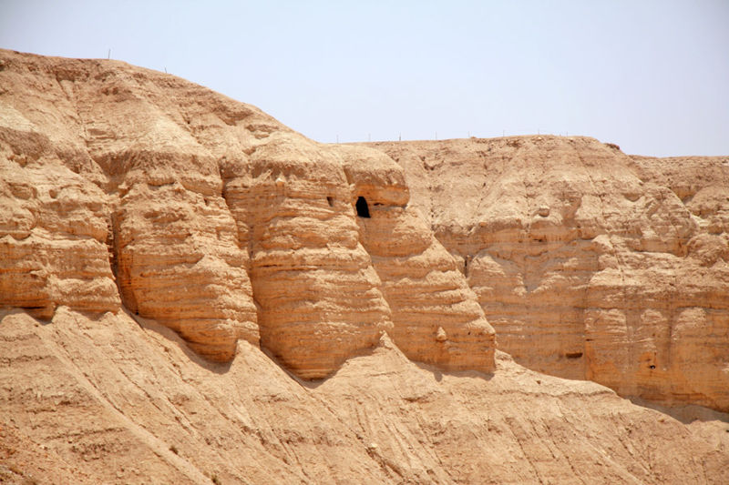
The Qumran Community

Slide 7
Cooperative Economics:
A Biblical and Practical Response to Poverty
The model of the early church
Cooperative are imbedded in the socio-cultural context of the Filipinos
Cooperativism is indigenous in the Philippines
The socio-political climate also makes cooperatives the most fitting enterprise in the country.

Slide 8
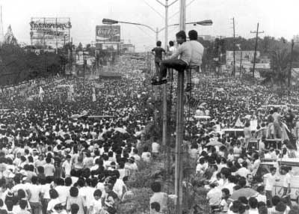
The EDSA Revolution

Slide 9
Nature of Organized Cooperatives
Cooperatives are service-oriented.
Cooperatives are people and community-centered
Cooperatives are owned, managed and patronized by their members
Cooperatives are business enterprise; they are created first and foremost to make money.
Cooperative advanced through self-help and mutual help.
Cooperatives achieve more for themselves and address the needs of their members.
Cooperatives are best organized when the members are recruited from the different sectors of society, like farmers, fishermen, wage earners, self-employed, professionals and the like.

Slide 10
Cooperatives:
A Biblical and Practical Response to Poverty in the Philippines
Although, Scriptures does not directly provide the organizational mechanism in cooperativism, but the values, principles and nature of cooperatives are founded in Scriptures.
For the author it is the most biblical and practical approach to alleviating the economic status of the poor and needy.

Slide 11
The Church Of and With the Poor
“Salvation is not only spiritual and individual but also physical and communal. More importantly, my main concern is that the Church will exercise and function as a prophetic community called to champion and rally for justice, righteousness and equal rights in economic growth of the poor and needy.”

